Slide 1
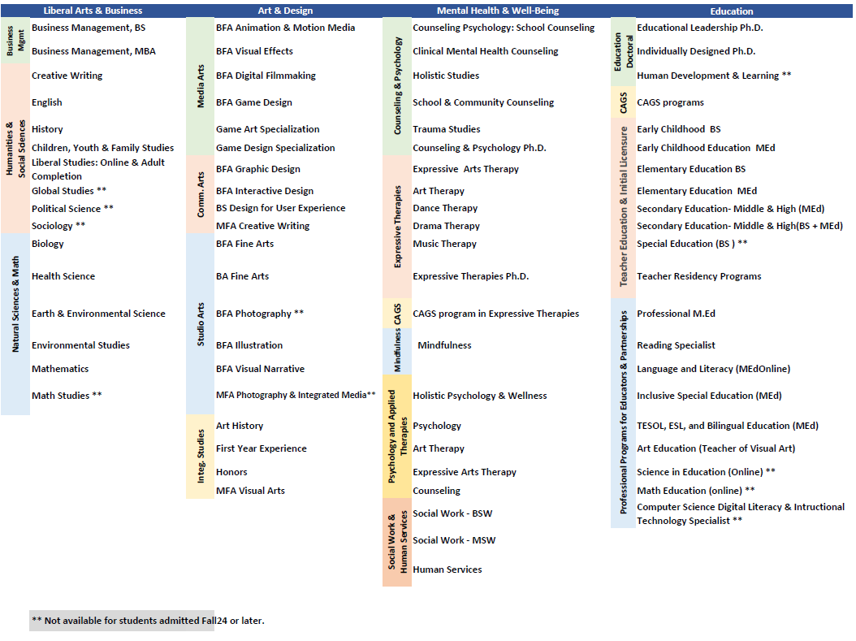
Program Table

Slide 2
Academic Council
Mental Health and Well-Being
Meenakshi Chhabra – Vice Provost
Brian Becker - Associate Provost
Joe Mageary - Associate Provost (as of 6/1/24)
Education
Stephanie Spadorcia – Vice Provost
Erika Dawes – Associate Provost
Val Shinas – Associate Provost
Liberal Arts and Business
Steve Shapiro – Vice Provost
Kim Keegan – Associate Provost
Sonia Perez-Villanueva – Associate Provost
College of Art and Design
Heather Shaw – Vice Provost
Catriona Baker – Associate Provost
Christine Collins – Associate Provost
Janet Steinmayer, President
Deanna Yameen, Interim Provost
Associate provosts:
Supervise faculty
Ensure programmatic quality

Slide 3
Academic Coordinators Council
Members:
Mental Health and Well-Being
Jen Pappas
Education
Venise Murphy
Liberal Arts and Business
Mary Powell
College of Art and Design
Atoosa Malekani
Led by: Lisa O’Neill, Director of Academic Affairs Administration

Slide 4
Department Chairs

